Slide 1
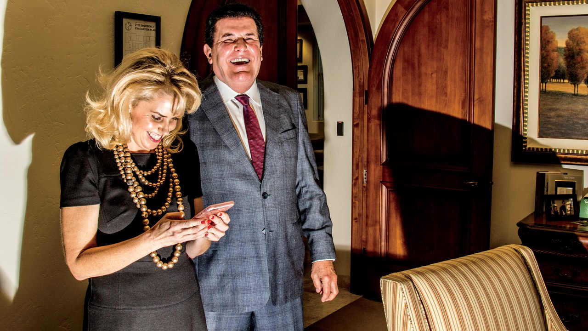
PETER POPOFF:
TRYING TO PLAY DEVIL’S ADVOCATE FOR AN OBVIOUS SCAM
BY: BEN TAUB

Slide 2

BEFORE WE BEGIN
DON’T BELIEVE HIS LIES
PROVEN FRAUD/SCAM
IS ON A .GOV WEBSITE
HE’S A BAD MAN

Slide 3
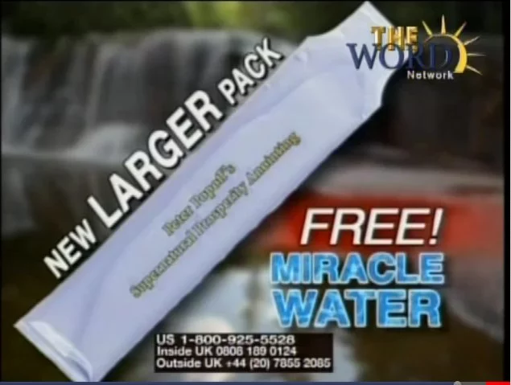
HIS BRAND
LATE NIGHT TELEVANGELIST/FAITH HEALER
LIVING DEBT FREE
MIRACLE SPRING WATER
MAIL IN DONATIONS?

Slide 4
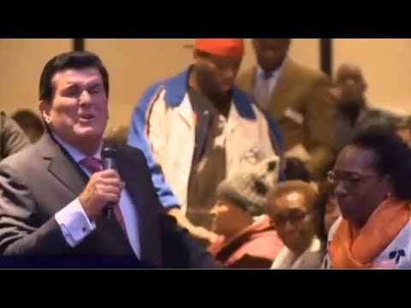
BRAND

Slide 5
REFORMULATION
TELEVANGELISM/LETTERS MORE CONVENIENT
DEBT, THE MODERN ILLNESS?
MIRACLE SPRING WATER = HOLY ARTIFACT

Slide 6
WHY REFORMULATION?
DEBT IS LIKE A MODERN DAY SICKNESS THAT MANY PEOPLE FACE
PROBABLY JUST THE QUICKEST WAY TO SCAM PEOPLE OUT OF MONEY :(

Slide 7
TARGET AUDIENCE
THOSE WHO ARE SICK (IN DEBT) AND IN NEED OF HELP

Slide 8
TARGET AUDIENCE
NAH, JUST KIDDING. HE WANTS DESPERATE/GULLIBLE PEOPLE.

Slide 9
IN CONCLUSION
HE HAS A BRAND BUT HE’S STILL A SCAM
HE’S STILL A BAD PERSON
MIRACLE SPRING WATER COMES FROM COSTCO.

